Slide 1
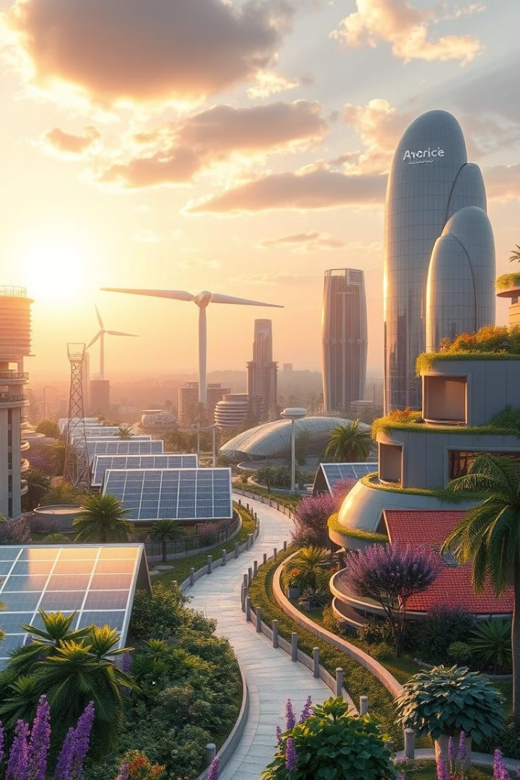
AI-Driven Climate Change Solutions
Unlocking a sustainable future through advanced AI for climate change prediction and mitigation.
By
Group 43 AI for Software Engineering,
Anayo Anigo, Linah Murithi, David Mwangi, Eunice Mumbi, Michael Waruiru

Slide 2



Addressing Global Climate Challenges
Rising Temperatures
Extreme Weather
Sea Level Rise
Global warming escalates, threatening ecosystems and human settlements. Urgent action is critical.
Increased frequency of floods, droughts, and storms disrupts lives and economies worldwide.
Coastal communities face displacement and infrastructure damage from relentless sea level increases.

Slide 3




AI-Powered Climatic Analytics
Our AI-driven platform revolutionizes climate forecasting and mitigation strategies.
Predictive Models
Emission Tracking
Adaptation Insights
Machine learning algorithms analyze vast climate datasets.
Real-time monitoring of greenhouse gas emissions for industries.
Data-driven recommendations for resilient infrastructure and agriculture.

Slide 4





Our Innovative Tech Stack
Cloud Computing
Scalable infrastructure supports massive data processing.
Big Data Analytics
Proprietary algorithms process petabytes of climate information.
Deep Learning
Neural networks enhance prediction accuracy and pattern recognition.
Secure Architecture
Robust cybersecurity protects sensitive climate data and models.

Slide 5

Impact: A Greener Future
20%
30%
Emission Reduction
Forecast Accuracy
Targeted strategies can reduce industrial carbon output significantly.
Improved climate predictions lead to better disaster preparedness.
15%
Resource Optimization
Efficient energy and water use across sectors via AI insights.

Slide 6
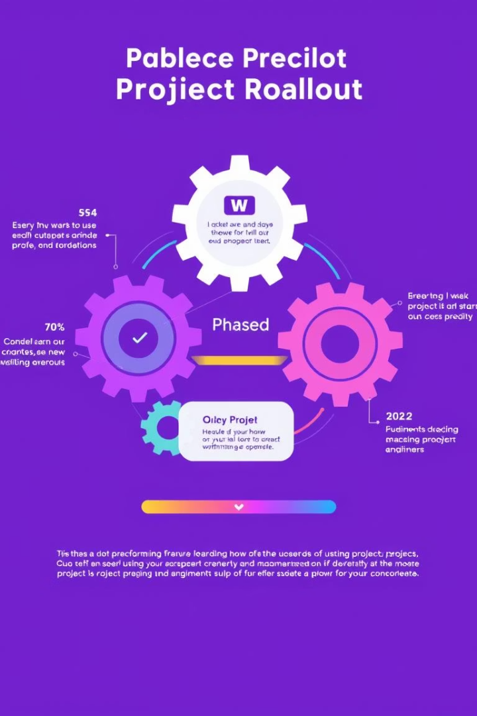
Strategic Implementation Phases
1
Phase 1: Data Integration
Aggregate global climate datasets and develop foundational models.
2
Phase 2: Pilot Programs
Deploy AI solutions in select regions for real-world testing.
3
Phase 3: Global Rollout
Expand platform access and scale operations worldwide.
4
Phase 4: Continuous Improvement
Regular model updates and feature enhancements based on feedback.

Slide 7

Stakeholder Benefits and Collaboration
Our AI platform offers unique advantages for diverse stakeholders.
Investors
Sustainable growth and market leadership in climate tech.
Governments
Enhanced policy-making and effective climate action plans.
Industries
Operational efficiency and reduced environmental footprint.
Communities
Increased resilience and better quality of life.

Slide 8




Join Us in Shaping the Future
Invest
Fund our mission for a sustainable tomorrow.
Partner
Collaborate on impactful climate initiatives.
Engage
Connect with our team to learn more.
Together, we can leverage the power of AI to build a resilient and sustainable future for generations to come. Your support is crucial.

